Slide 1
Day 13
Kinematics of Wheeled Robots

Slide 2
Wheeled Mobile Robots
robot can have one or more wheels that can provide
  steering (directional control)
  power (exert a force against the ground)
an ideal wheel is
  perfectly round (perimeter 2πr)
  moves in the direction perpendicular to its axis

Slide 3
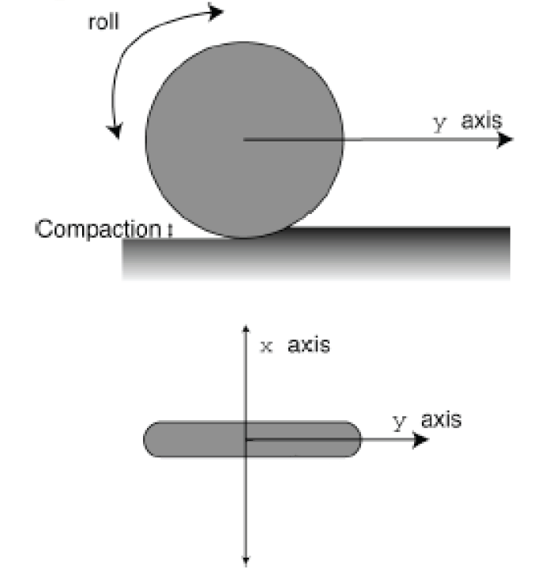
Wheel

Slide 4
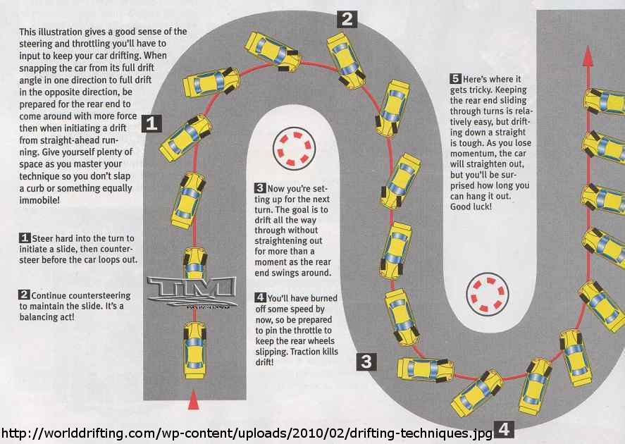
Deviations from Ideal

Slide 5
Instantaneous Center of Curvature
for smooth rolling motion, all wheels in ground contact must
  follow a circular path about a common axis of revolution
    each wheel must be pointing in its correct direction
  revolve with an angular velocity consistent with the motion of the robot
    each wheel must revolve at its correct speed

Slide 6
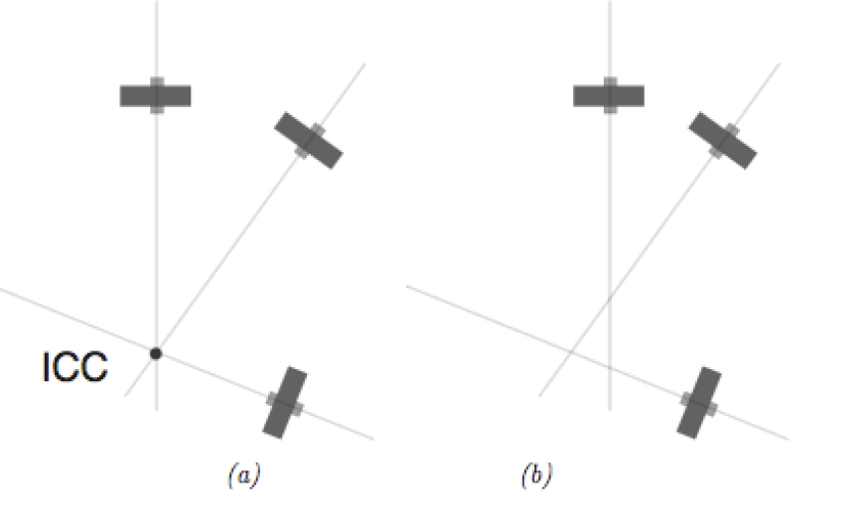
Instantaneous Center of Curvature
3 wheels with roll axes intersecting at a common point (the instantaneous
center of curvature, ICC). (b) No ICC exists. A robot having wheels shown in
can exhibit smooth rolling motion, whereas a robot with wheel arrangement
(b) cannot.

Slide 7
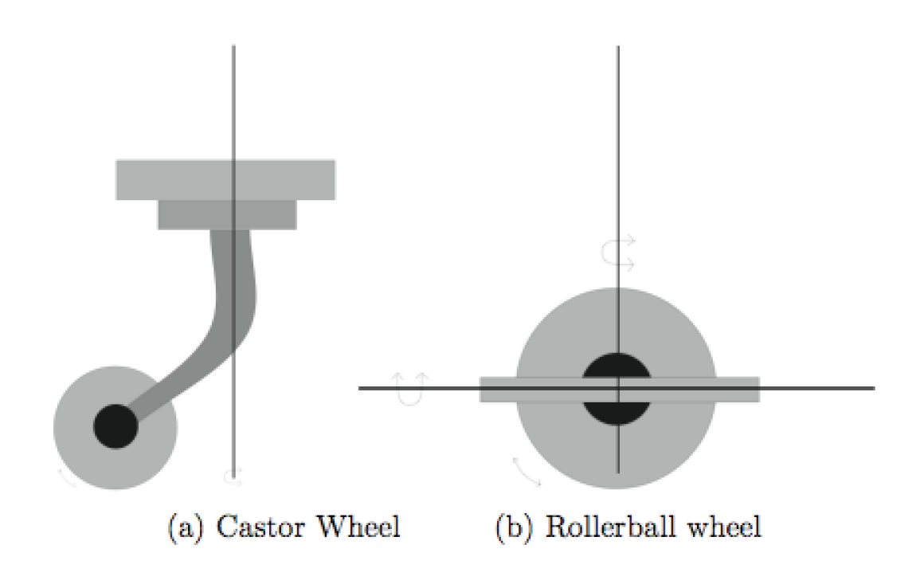
Castor Wheels
provide support but not steering nor propulsion

Slide 8
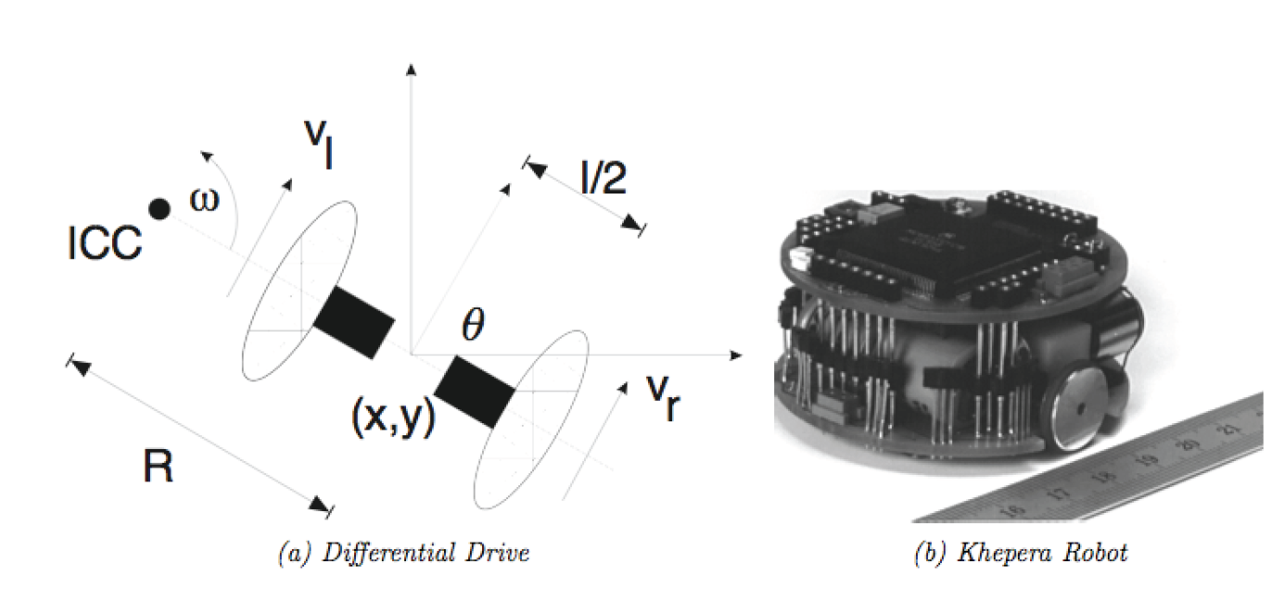
Differential Drive
two independently driven wheels mounted on a common axis

Slide 9
Differential Drive
velocity constraint defines the wheel ground velocities

Slide 10
Differential Drive
given the wheel ground velocities it is easy to solve for the radius, R, and angular velocity ω

Slide 11
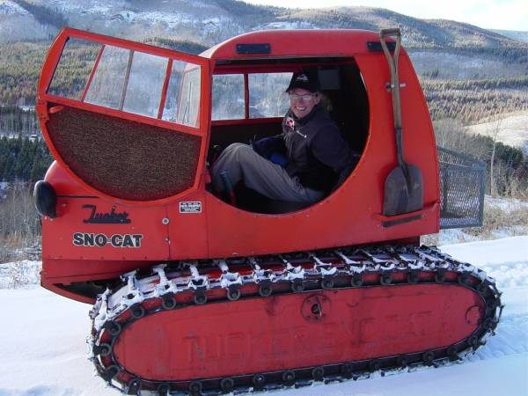
Tracked Vehicles
similar to differential drive but relies on ground slip or skid to change direction
  kinematics poorly determined by motion of treads
http://en.wikipedia.org/wiki/File:Tucker-Kitten-Variants.jpg

Slide 12
Steered Wheels: Bicycle

Slide 13
Steered Wheels: Bicycle
important to remember the assumptions in the kinematic model
  smooth rolling motion in the plane
does not capture all possible motions
  http://www.youtube.com/watch?v=Cj6ho1-G6tw&NR=1#t=0m25s

Slide 14
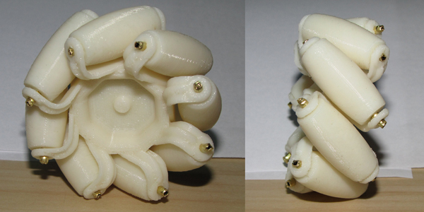
Mecanum Wheel
a normal wheel with rollers mounted on the circumference
http://www.youtube.com/watch?v=Cee1UZN0p98&feature=player_embedded
http://blog.makezine.com/archive/2010/04/3d-printable-mecanum-wheel.html

Slide 15
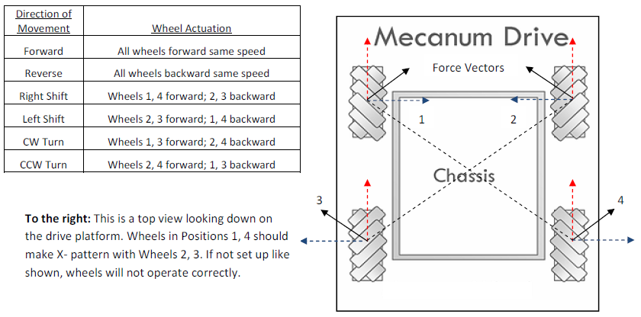
Mecanum Wheel
AndyMark Mecanum wheel specification sheet
http://d1pytrrjwm20z9.cloudfront.net/MecanumWheelSpecSheet.pdf

Slide 16
Forward Kinematics
serial manipulators
  given the joint variables, find the pose of the end-effector
mobile robot
  given the control variables as a function of time, find the pose of the robot
    for the differential drive the control variables are often taken to be the ground velocities of the left and right wheels
      it is important to note that the wheel velocities are needed as functions of time; a differential drive that moves forward and then turns right ends up in a very different position than one that turns right then moves forward!

Slide 17
Forward Kinematics
robot with pose [x y θ]^{T} moving with velocity V in a direction θ measured relative the x axis of {W}:
V
θ
{W}

Slide 18
Forward Kinematics
for a robot starting with pose [x₀ y₀ θ₀]^{T} moving with velocity V(t) in a direction θ(t) :
V
V sin θ
θ
V cos θ

Slide 19
Forward Kinematics
for differential drive:

Slide 20
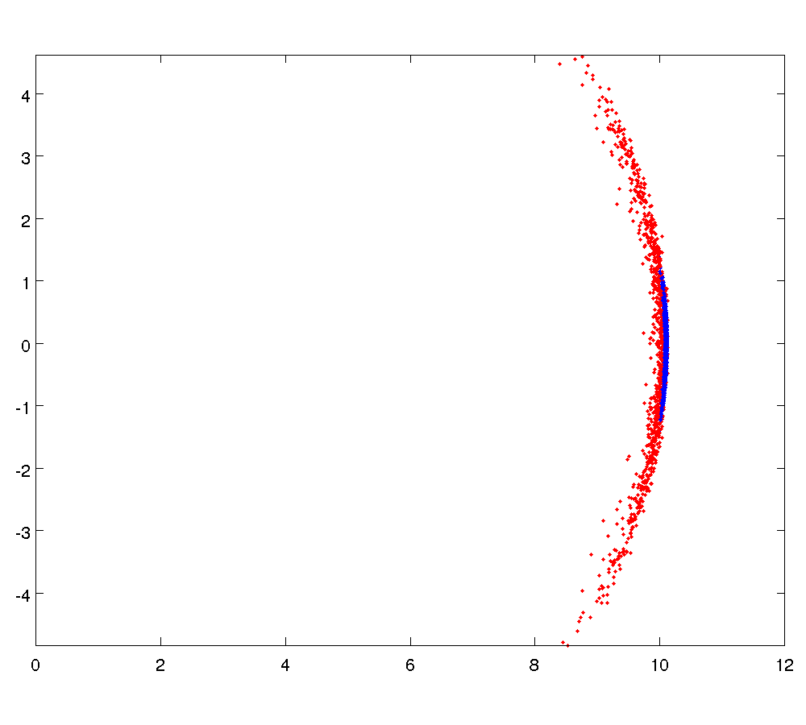
Sensitivity to Wheel Velocity
σ = 0.05
σ = 0.01

